Slide 1
Indices of Social Development
Developing 6th Index
Ellen Webbink

Slide 2
Indicators available
ISD intended to have 6 indices, but the Inclusion Index was dropped because…
Diagnostics paper:
“… more substantial measure, has been to remove the inclusion of minorities index from the set of indices for the time being, until more robust data becomes available.”

Slide 3
Inclusion of minorities assesses levels of discrimination against vulnerable groups such as indigenous peoples, migrants, refugees, or lower caste groups;
Inclusion of minorities assesses levels of discrimination against vulnerable groups such as indigenous peoples, migrants, refugees, or lower caste groups;

Slide 4
All indices have 4 kinds of indicators
Notes:
Proxy: variables based upon the measurable outcome of social institutions

Slide 5
Challenge: Include proxy variables:
Similar to Gender Equality measure: socio-economic indicators
(Education/occupation/income)

Slide 6
Process
Update ‘old’ data: Latinobarometer, Afrobarometer, Fund for Peace, International Country Risk Guide, Minorities at Risk, World Value Surveys
Behavorial: e.g. Could you please sort out any that you would not like to have as neighbors.
Public opinion: e.g. As far as you know, which of the following groups is most discriminated against in this country
Expert assessment: Level of ethnic and religious tensions, International Country Risk Guide rating
Include ‘new’ data: European Value Studies, European Social Survey and proxy variables

Slide 7
New Variables
New variables
- Proxy Variables:
Education: Distance to the standardized mean in education (years) across ethnic groups
Occupation 1. Distance to the standardized mean in occupation(upper nonfarm) across ethnic groups
Both from various sources: DHS, Barometers, ISSP
Occupation 2 : OECD: ratio’s labour engagement immigrants vs. native-borns
- Opinion:
ESS questions on immigrants

Slide 8
New Variables
Some diagnostics: ESS
Notes:
You can do this for every indicator

Slide 9
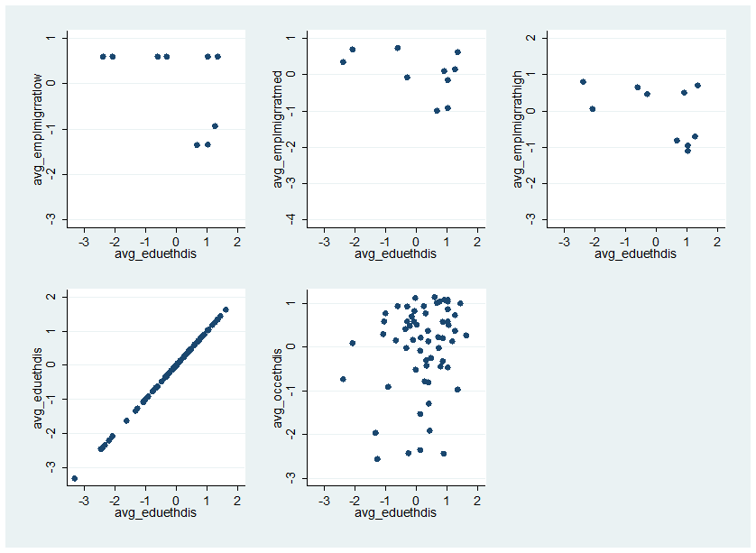
New Variables
Some diagnostics: Proxy Variables

Slide 10
New Variables
Some diagnostics: Factor Loadings

Slide 11
New Variables
After indexing: results
Notes:
Ranging from 0.44 to 0.54.
Sudan lowest, Iceland highest.

Slide 12
New Variables
Relationships with other indices
Notes:
High involvement in clubs and associations, low score on ethnicity, probably says more about the clubs and association index. There is a negative bivariate association

Slide 13
New Variables
Relationships with other variables
Notes:
Monaco is outlier with High GDP

Slide 14
New Variables
Future
Include more proxies (Language groups)
Include occupational data for Non-OECD countries
Include and test other suggestions?
Include ESV data (as new waves will be available)
Available on the website (www.IndSocDev.org) in January 2012!

